Slide 1
INTEGRATING TECHNOLOGY INTO THE CLASSROOM
A 21ST CENTURY CLASSROOM
BAUMAN MOSCOW STATE TECHNICAL UNIVERSITY
Virginia G Simmons, PhD

Slide 2


Slide 3
THE MOST IMPORTANT THING THAT SCHOOLS CAN DO
IS
NOT TO ADD MORE TECHNOLOGY
BUT
TO USE IT MORE EFFECTIVELY.

Slide 4

John Dewey
1859-1952

Slide 5
TECHNOLOGY
The only constant in the technology industry is change. Mark Bennett
TECHNOLOGY IS NOT GOING AWAY.

Slide 6
Bill Daggett, President of THE Center for Leaders in Education
“WHEN STUDENTS ENTER OUR SCHOOLS, THEY ARE ENTERING THE HISTORICAL MUSEUM OF TECHNOLOGY.”

Slide 7
THINK-PAIR-SHARE
Think for a few minutes about this saying. Choose a partner. Discuss this with your partner. Share with group.
  1. What does this Daggett quote mean to you?
  2. If this is true, what does it mean to your students?

Slide 8
What is happening in the world in 2018?
Did you Know?
This is about the USA and it goes very fast. However, you can transfer the knowledge.

Slide 9
Let’s watch another one.
Again, very fast and about the USA.

Slide 10
We are preparing our students to walk out the door.
What about the world that they walk into?

Slide 11
INSTANT FEEDBACK
IT IS NOT ABOUT WHAT WE TEACH, IT IS ABOUT WHAT THE STUDENTS LEARN.
John Hattie, VISIBLE LEARNING

Slide 12
INSTANT FEEDBACK
IT IS NOT ABOUT WHAT WE TEACH, IT IS ABOUT WHAT THE STUDENTS LEARN.
WHAT HAVE YOU LEARNED FROM THE VIDEOS KAHOOT.COM

Slide 13
Google classroom
https://edu.google.com/k-12-solutions/classroom/?modal_active=none
Full Collaboration with G Suite for Education

Slide 14
G Suite for Education
email, chat, video conferences,
Co-edit documents, presentations in real time
Schedule meeting, reminders
Create classes, give quizzes, give feedback
Configure security settings, manage devices

Slide 15
EDMODO.COM
THIS ALLOWS YOU TO
  SET UP CLASSES
  GIVE ASSIGNMENTS
  SEND MINDERS
  GRADE ASSIGNMENTS
  ANSWER QUESTIONS
  GIVE TESTS
  FLIP YOUR CLASSROOM

Slide 16
TED TALKS, TEDED, TEDX
Let’s watch the first 3 minutes of this video on the acquisition of language.
TECHNOLOGY
ENTERTAINMENT
DESIGN

Slide 17
WHY USE TED
Valuable Information
Speakers with different accents
Speakers knowledgeable about the subject
Lesson plans built into TED.ED
Videos are great resources for differentiated classroom

Slide 18

You Might Want to Look At This
Before You Listen
Vocabulary
Listen for Main Idea
Listen for Details
Use an Outline
Think Critically
Speaking – Communicate
Syllable Stress
Collaborate
Work with a partner

Slide 19
KHAN ACADEMY
Short videos on Academics. Students can take full courses.
Why?
Flipped Classroom, Differentiation in Classroom, Self Study

Slide 20
Now a Device
This device is useful for all, but especially useful for those who have a disability:
Blind
Visually Impaired
Learning Disabled
ADHD-ADD

Slide 21
Corpus of Contemporary American English
Increase the vocabulary of your students. Let them find words that are used in context.
560 million words in context

Slide 22
Cannot End Without Sharing Something That You Have With You Everyday.
Turn on your device (share if you don’t have one)
Go To General
Go To Accessibility

Slide 23
Cannot End Without Sharing Something That You Have With You Everyday.
DO NOT TURN ON “VOICE OVER” YET
Take a few minutes and look at the items that are in ACCESSBILITY

Slide 24
Cannot End Without Sharing Something That You Have With You Everyday.
NOW, TURN ON ‘VOICE OVER’
With voice over you can draw letters on the screen and have them translated to text in mail, notes and other applications.

Slide 25
Cannot End Without Sharing Something That You Have With You Everyday.
Voice Over has a virtual control called a rotor that you can just dial with two fingers on the screen.

Slide 26
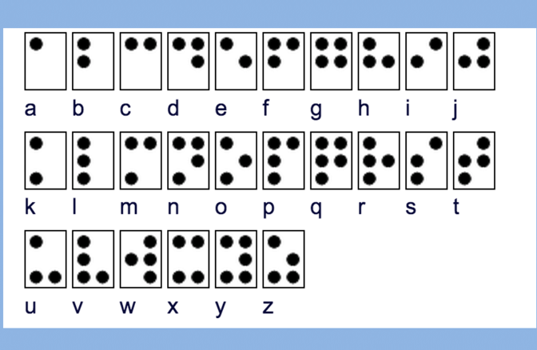
On your device, in voice over, you actually have a braille screen
.

Slide 27
THE POSSIBILITIES OF TECHNOLOGY ARE ENDLESS!
If the brilliant Stephen Hawking can talk by flexing a muscle and typing with a chip implanted in his cheek, what else?
When you limit others, you limit yourself.

Slide 28

QUESTIONS? COMMENTS!

